Slide 1
Presidential Scandals
Watergate, Iran/Contra, Clinton/Lewinsky
Plus Bush, Obama, Trump Controversies

Slide 2
Lecture Outline
What Gets a President in Trouble
What Protects a President
Modern Scandals
Watergate
Iran/Contra
Clinton/Lewinsky
Summary
Criteria for Impeachment
Battle for Public Opinion
Signs of Trouble
Obama and Trump Scandals/Controversies

Slide 3
How Presidents Get in Trouble
The Basics
Over the course of American history, a number of factors have arisen that have damaged presidencies
Though only 3 presidents have been impeached, none have been formally removed, but at least 21 of 45 (almost 50%) presidents have been seriously hurt politically by a controversy or scandal while in office
How does a president get in trouble politically?
Disputes over policy – sometimes policy disputes become extremely intense, as they did in the debates about the national bank (1830s) and over how the Cold War should be fought (1980s)
Divisive wars – A half-dozen wars have caused intense divisions within the country...each has hurt the president in power
Bad economic conditions – Every president knows that an economic downturn (or recession) can be politically devastating
Scandals – When a violation of law can be linked to the white house, this means trouble for the president
Notes:
Isn’t it really polarization that matters? Doesn’t polarization increase the intensity of policy disputes, differences over war, and the likelihood scandal will be made an issue? Well, it’s a two-way street. Policy disputes and war cause polarization—and—polarization increases the intensity over these issues. Polarization definitely increases the likelihood of scandal. In a non-polarized environment, where there is comity in our system (typically when one party dominates), there would be fewer scandals because we wouldn’t be looking for them as often as we do in a polarized environment.

Slide 4
Intense Policy Disputes
Policy Disputes Can Destroy a Presidency
Economic policy: The national bank and the gold standard
Jackson (1829-1837) and Tyler (1841-1845) hurt by fights over national bank
Cleveland (1881-1885; 1893-1897) lost the support of the Democratic party by siding with Republicans on the gold standard (sound money)
Slavery policy: The divisions over slavery were the most intense in American history...the country was never more polarized
Fillmore (1850-1853), Pierce (1853-1857), Buchanan (1857-1861), each failed to address the slavery issue
Reconstruction policy: Led to impeachment of A. Johnson
A. Johnson (1865-1869) was also on the wrong side of history for wanting leniency on the South in post-Civil War America.
Foreign policy: The League of Nations & Iran/Contra
Wilson crippled by Senate rebuke of Treaty of Versailles, which created League of Nations (precursor to the United Nations)
Reagan nearly faced impeachment over trading arms for hostages and for an illegal diversion of money (Iran/Contra Scandal)
Notes:
After killing the national bank, Jackson was censured by Senate for placing federal deposits in state banks; Tyler was kicked out of Whig party after vetoing the Whig policy agenda which came out of Congress; Cleveland was dumped by Democratic Party in 1896 election after siding with Wall Street bankers and investors (i.e., the monied interests over farmers) during his presidency.
Buchanan, Pierce and Fillmore did nothing to end slavery, which was an issue that gained intensity in the 1850s.
Both Wilson’s and Reagan’s foreign policies were very controversial—and during the Bush43 years, the country was intensely divided over the Iraq War.

Slide 5
Divisive Wars
Divisive Wars Destroy Presidencies
Quasi War with France – Adams (1797-1801) fought a limited naval war with France; Adams lost support of his own party, which wanted all-out war with France; Adams lost 1800 presidential election
Mexican-American War – Polk (1845-1849) was accused of fighting an “unconstitutional” war, formally rebuked by Congress, did not receive the nomination of his party for a second term
Civil War – Lincoln (1861-1865) was assassinated by a Southerner
Korean War – Truman (1945-1953) left office with low public approval because the US could not win Korean War, Truman faced opposition from his own party in 1952 primaries, chose not to run in ‘52
Vietnam War – LBJ (1963-1969) could not win Vietnam War, faced strong opposition from his own party in the 1968 primaries, chose not to run in ‘68
Nixon (1969-1974) became paranoid about intelligence leaks used to discredit the war, led him to create the “plumbers,” which eventually led to the Watergate scandal and to his resignation from office
Notes:
Each of the presidents profiled on the slide either lost reelection, were dropped by their own political party in favor of another candidate in the next election cycle, or chose not to run for reelection, all because a divisive war damaged them so severely politically.
The Iraq War may also belong on this list. Bush43, however, won reelection in 2004. So, the Iraq War was not so damaging as to cause Bush to lose his reelection bid. But the opposition wanted to see Bush pay for getting America involved in Iraq: lots of scandals circled Bush, each having something to do with Iraq or with the war on terrorism—1) allegedly taking the country to war under false pretenses, 2) the CIA leak case, 3) domestic spying (terrorist surveillance), 4) tracking financial transfers between America and other countries to search for Al Qaeda activity, etc. Though Bush won reelection, the American people later gave Bush a rebuke in 2006 and 2008, bringing the Democrats to power in Congress in 2006 and increasing their margins in 2008 and electing a Democratic president (Barack Obama).
Immediately following the Persian Gulf War (1991), Bush41 experienced an enormous boost in the polls, but 1 ½ years later, it didn’t help him win reelection. He was easily beaten by Bill Clinton in 1992.

Slide 6
The Economy & Scandals
Recessions & Scandals Can Destroy Presidencies
The Economy – Poor economic conditions
Van Buren (1837-1841), Hoover (1929-1933), Carter (1977-1981), and Bush41 (1989-1993) failed to win reelection bids
Bad economic conditions (or the perception of those conditions, as in the case of Bush41) in the country contributed to election loses in each of these cases
Scandals – Five major scandals in the past 50 years, each involving alleged violations of law
Nixon (1969-1974) resigned over Watergate; he was likely to have been impeached and removed from office
Reagan (1981-1989) survived after his National Security Advisor took responsibility for an illegal transfer of funds during Iran/Contra
Clinton (1993-2001) survived the Lewinsky matter after the public rallied around him, concluding Clinton’s private life did not effect his presidency
Trump I (2019-20) survived the Ukraine matter given intense polarization, thus having the support of his party in the U.S. Senate
Trump II (2021) survived after it was concluded that “fight like hell” is language often used in political rhetoric, by Democrats and Republicans
Notes:
There were lots of scandals surrounding President Bush and Vice President Cheney but none rose to the level of an impeachment or impeachment-like scandal. Barack Obama endured a couple of “potential” scandals that never materialized (see slides 16 and 17 for Obama scandals, and last slide for more on Bush43).
The Biden Presidency
Joe Biden is protected from impeachment because he enjoys unified government at the outset of his presidency (January 2021), but should Republicans win a majority in the U.S. House in 2022, then Biden could face an impeachment inquiry. Almost certainly, Republicans would look into Biden’s business relationship with his son (Hunter Biden) and brother (James Biden), searching for any corrupt bargains that Biden might have made to help his son and brother secure business deals with the governments of Ukraine, China, and Russia, or with businesses tied to the governments of any of those countries. What Republicans would try to uncover is whether Biden profited personally from any of these business deals and whether there were any understandings or agreements that Biden would provide access to powerful people in the U.S. government in exchange for overseas governments or overseas businesses doing business with his son and brother.

Slide 7
What Protects a President?
What factors provide protection for a president?
Unified Government – Exists when majorities in Congress are controlled by the same political party as the president
Unified government almost guarantees that a president will not face impeachment proceedings, but it doesn’t stop a serious primary challenger in a president’s bid for reelection
Public Support – In the modern age of public opinion polls, the president’s opposition is reluctant to mount an offensive when the president enjoys strong public support
One reason Clinton survived his impeachment ordeal was due to strong public support (nearly 70% approval at the height of the impeachment scandal)
Reagan also enjoyed strong public support during the Iran/Contra scandal, and he too survived
Trump I survived too, not because the public strongly backed his position, but because public opinion was fairly evenly split, meaning it was not strong enough against him to scare his own party into voting against him
Notes:
The factors that protect a president are easy to identify but hard for a president to make work in his favor. For instance, presidents often actively campaign to encourage the American people to give his party majorities in Congress (or to increase those majorities, when they already exist), but these efforts rarely succeed, unless it is a presidential election year and the candidate or incumbent president is very popular with the American people.
Joe Biden begins his administration (as of Jan. 2021) with unified government, so he is almost certainly protected from any potential impeachment inquiry. Also, the Biden administration begins (as of Jan. 2021) with former President Trump facing a second impeachment for allegedly inciting violence at the Capitol Building on 6 January 2021, presumably in an effort to overturn the 2020 presidential election outcome. So, as Biden begins his presidency, there is no focus on him; all eyes are still on the former president, Donald Trump.
Donald Trump began his presidency (in 2017) with a majority Republican Congress, which protected him from impeachment trouble. Even though Trump fought with his own party during the 2016 presidential campaign, and many joined in on the “dump Trump” movement to replace him as the nominee when an audio tape was released, on which he had made lewd comments about the female anatomy, among his Twitter rants as president, Republicans in the U.S. Senate stuck with Trump during his first impeachment (2019-20).
George W. Bush enjoyed unified government from 2001 to 2007, but once the Democrats took over Congress in the 2006 midterm elections, they backed off on the calls for impeaching Bush. Impeachment backfired on a Republican US House when it impeached Clinton in 1998. Coming out of the 2006 midterm elections, Democrats believed they were in a position to win in 2008, so the Democrats didn’t want to take the risk of impeachment potentially backfiring on them. In early 2007, Nancy Pelosi, the Speaker of the House, went on record saying the Democrats would not move to impeach Bush.

Slide 8
What Protects a President?
What factors provide protection for a president?
“Nip problems in the bud” – A president must address problems early
Throughout American history, presidents have fired subordinates who have been caught doing something unethical or illegal
Bush43 resolved the China hostage crisis (2001) quickly, saving himself from a prolonged hostage crisis such as what Carter and Reagan faced
Maintain party support – 11 presidents have lost their own party’s support, and each was ruined politically
This is why most presidents cater to their party base (the core ideologues and party activists)
Appointing conservative pro-life judges to the federal courts was one way Bush43 (2001-2009) and Trump (2017-2021) maintained the support of their core base of pro-life conservatives
Joe Biden can maintain his core liberal base of support by reversing Trump initiatives and by pursuing more government-provided health care and by pushing an aggressive agenda addressing climate change
Notes:
Here are some examples of past presidents who “nipped problems in the bud.”
Trump Administration
Just 24 days into his presidency, Trump fired his National Security Advisor (NSA), Michael Flynn, for lying to VP Mike Pence about Flynn’s interaction with the Russian ambassador during the presidential transition (after Trump was elected, but before Trump was sworn into office). Pence was questioned about Flynn’s interactions with the Russian ambassador, and Pence said that there had been no interaction. That turned out not to be true, and Trump fired Flynn. It was a smart move for Trump to fire his subordinate because it makes him look like he rooting out a bad actor; Trump is on the side of reform, making things more honest and ethical, at least that’s the appearance Trump wanted to portray to the public.
Trump failed to “nip the problem in the bud” regarding the Capitol Building riot (Jan. 6 2021). He could have conveyed a more truthful message to his supporters, and he could have implored the crowd not to engage in violence at the Capitol. Given the law on counting electoral votes, there was no means by which the Republicans in Congress could change the electoral vote in 2020; Republicans did not have the numbers necessary win an objection to the electoral vote in any state (e.g., Arizona, Georgia, Pennsylvania, Wisconsin). Trump spoke to the crowd at the Save America March (Jan. 6 2021) for over an hour, and he could have added a couple of sentences, urging the crowd to respect the Capitol police and not to engage in violence. At one point in the speech, he just simply stated that the crowd would walk down to the Capitol “peacefully and patriotically” and at another point in the speech he complimented his supporters, claiming that they are the ones who built America rather than tearing it down (a reference to the presumably left-wing rioters in Summer 2020 who looted and burned down businesses in Minneapolis, Portland, Seattle, NYC, and elsewhere), but Trump needed to explicitly implore his supporters not to engage in violence. He could have couched the appeal as a critique of his political opponents by saying something like, “We can’t be like the radical left who are never held to account for their violence; we have to be better than that; don’t do violence, just make your voices heard.”
Obama Administration
Through back channels, Obama’s Secretary of Agriculture Tom Vilsack forced Shirley Sherrod to resign her position after an edited video clip of a speech she had made at an NAACP conference was made public in July 2010, in which it had appeared that Ms. Sherrod had discriminated against a white farmer 25 years earlier while she was in a previous agricultural position in the State of Georgia. 24 hours later, the full video was released, revealing that Ms. Sherrod was not a racist and that she had helped the white farmer stay in business. Had the Obama administration waited one more day, it could have defended Ms. Sherrod from allegations that she was a racist, but a race controversy is too politically dangerous for a president to wait one day, so the administration “nipped the problem in the bud” and forced out Sherrod. Later, Ms. Sherrod was offered a better job at the Agriculture Department, but she declined to pursue other opportunities.
Bush 43 Administration
Bush fired Secretary of Defense, Donald Rumsfeld, the day after the 2006 elections, when the Democrats took majorities in both houses of Congress. Rumsfeld was one of the chief architects of the Iraq War, and consequently was constantly targeted by Democrats and liberals. Once Bush cut Rumsfeld loose, the controversy surrounding Rumsfeld disappeared. Bush also cut loose his Attorney General, Alberto Gonzalez, who was under fire by a Democratic Congress over the issue of the Bush administration’s firing of 8 US District Attorneys, who allegedly refused to prosecute Democrats. Congress backed off of its investigation as soon as Bush fired Gonzalez.
Even though Bush “sold-out” his base on issues of big government as well as others (e.g., Bush did not cut spending; he added prescription drugs to Medicare; he increased the role of the federal government in education; under Bush, the federal government intervened in the investment banking, home mortgage and insurance industries; and he sided with business on the immigration issue). Bush was conservative on other issues (a Christian evangelical, opposed to gay marriage, opposed to stem cell research (using embryos for medical research), appointed pro-life judges to the federal courts, catered to his pro-life base by signing legislation to allow the federal courts to hear the case of Teri Shiavo (who was in a vegetative state for 15 years and whose husband wanted to “pull the plug” and let her die), signed a series of tax cuts into law, aggressively fought the war on terrorism), which saved him with his base. The point here is that a president can disregard his core base of support on some issues and survive politically as long as he gives them something on other issues.
Presidents who Lost their (Party) Base of Support
Which presidents lost the support of their own political parties? Adams, Tyler, Fillmore, Pierce, Buchanan, A Johnson, Cleveland, L. Johnson, Nixon, Carter, Bush41…Carter and Bush41 faced challengers from their own parties in the presidential primaries, which they survived, but then were defeated in their respective general elections. The other presidents in the list either chose not to run for reelection or were passed over by their respective parties for nomination or were defeated in their reelection bids.

Slide 9
The Watergate Scandal
Watergate (1972-1974)
Summary: In June 1972, 5 burglars were caught breaking into the Democratic National Committee headquarters at the Watergate office and apartment complex in Washington DC.
These burglars and two others picked up by police later were linked to the Committee to Reelect the President, which had close ties to then President Nixon’s administration
Nixon and his top aids engaged in a cover up of the Watergate break-in
For 3 weeks, Nixon tried to get the CIA to call off the FBI investigation of the break-in, arguing that it would reopen the Bay of Pigs fiasco (the Watergate burglars were Cuban)
A taping system in the White House was later subpoenaed by Congress with Nixon giving the order to commit obstruction of justice (obstructing an FBI investigation)
The House Judiciary Committee voted to impeach Nixon on 3 articles in July 1974
Nixon resigned in August 1974, the first and only US president ever to resign from office
Notes:
The Bay of Pigs was a planned US-supported invasion of Cuba (1961) by Cuban exiles who had left Cuba after Fidel Castro took over. The Bay of Pigs invasion was a disaster. President Kennedy called off the air cover that the US was supposed to provide to the Cuban exiles. Kennedy felt he had been lied to by the CIA, that he had not been fully briefed on the CIA plans to take back Cuba from Castro. Castro’s forces easily repelled the invasion.
Nixon’s cover-up story: Cuban Americans were still smarting from Kennedy’s decision to abandon them in 1961 and they wanted revenge on the Democratic Party. That’s why they broke into Democratic headquarters to get information that could be used against Democrats in the upcoming presidential election (1972). The truth is that Nixon’s campaign reelection team wanted to get dirt on the Democrats to use it against them in the 1972 presidential election. The Cuban connection was just a cover.
Source: https://en.wikipedia.org/wiki/Impeachment_process_against_Richard_Nixon#Articles_of_impeachment
Articles of impeachment considered by House Judiciary Committee
Article I: Obstruction of Justice Passed 27–11; Democrats: 21 yes, 0 no; Republicans: 6 yes, 11 no
Article II: Abuse of Power
Passed 28–10; Democrats: 21 yes, 0 no; Republicans: 7 yes, 10 no
Article III: Contempt of Congress
Passed 21–17; Democrats: 19 yes, 2 no; Republicans: 2 yes, 15 no
Article IV: Cambodia bombing
Failed 12–26; Democrats: 12 yes, 9 no; Republicans: 0 yes, 17 no
Article V: Failure to pay taxes
Failed 12–26; Democrats: 12 yes, 9 no; Republicans: 0 yes, 17 no

Slide 10
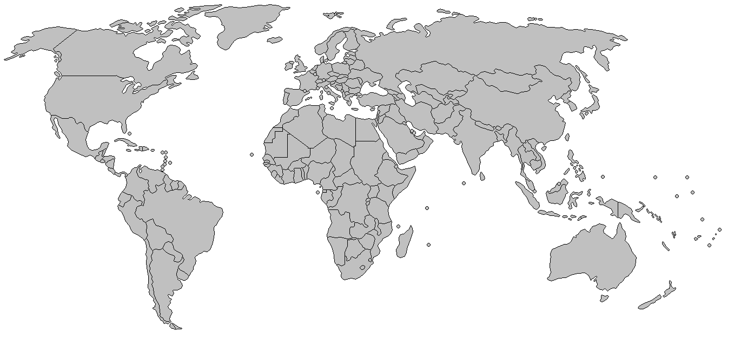
The Iran/Contra Scandal Mid-1980s
Profits from arms sales to Iran were not deposited in the US treasury but rather diverted to anti-communist rebels in Nicaragua
Iran
Nicaragua

Slide 11
The Iran/Contra Scandal
Iran/Contra (1986-1987)
Summary: The Reagan Administration secretly sold arms to Iran in 1985-1986 in return for the release of American hostages being held by Shiite Muslim groups in Lebanon (Iran had influence over the hostage takers)
Iran was “overcharged” for the weapons, and the “extra profits” were funneled to the Nicaraguan Contras, who were in a struggle to overthrow the communist government in Nicaragua and whose funding had been cut off by the US Congress in 1985
The deal was in clear violation of Reagan Administration policy not to make concessions to terrorists (Iran was/is a terror-sponsor state)
The diversion of money to the Contras was also a violation of law (The Boland Amendment): the law cut off US funding to the Contras
Congress dropped the investigation after it could not reveal a “smoking gun” directly linking Reagan to the illegal acts
John Poindexter, National Security Advisor, claimed to have given the order for the diversion of funds, thus saving Reagan from impeachment
Notes:
The arms for hostages deal did not result in a net release of hostages: 3 hostages were released initially, but 3 different Americans were taken hostage later...the CIA chief in Beirut, Lebanon (William Buckley) was tortured and killed...Both the Americans and Iranians felt screwed by the whole affair; the Iranians expected different weapon systems than they actually received from the US, and the US expected all of the hostages to be released. So, in the end, not only did the policy violate Reagan administration policy not to make deals with terrorists or their state sponsors (Iran in this case) as well as violate the law (the Boland Amendment) and separation of powers in the Constitution (only Congress can appropriate monies as aid to the Contras), the policy was a failure—it did not result in a net release of American hostages being held in Beirut, Lebanon.
One significant difference between Iran/Contra on the one side and Watergate and Clinton/Lewinsky on the other was that Reagan was driven by an ideological goal, to eliminate communists from Nicaragua. Reagan had a justifiable goal in mind (i.e., defeating communists, spreading democracy), though some 20 people went to jail for crimes that were committed in carrying out that goal. On the other hand, Watergate was personal, with Nixon wanting to destroy his political opponents (and of course, they wanting to destroy him). In addition, Watergate involved hush money, and whenever there is money involved, it adds an element of corruption, greed, blackmail, etc. to the scandal (Iran/Contra involved a diversion of money to the Contras, money that belonged to the U.S. Treasury, which makes Iran/Contra perhaps the most serious violation of the U.S. Constitution and of the separation of powers principle among these scandals). Clinton’s scandal was personal as well. Clinton wanted to enjoy the spoils of the presidency, one of which is having women throw themselves at him, while his political opposition viewed him as morally depraved and undeserving of the presidency (similar to how Democrats viewed Trump, also as beneath and undeserving of the presidency). Trump’s Ukraine scandal was purely personal, similar to Nixon, Trump wanted “dirt” on Joe Biden, who he anticipated would be his likely rival in the 2020 presidential election. Reagan stands out among these presidents, in a positive way, because he did not stand to benefit personally (George W. Bush also had an ideological goal in invading Iraq in 2003, so his political motives were not personal either, though he and his family (his father, George H.W. Bush) were accused of having personal ties to Saudi Arabian oil money).

Slide 12
The Clinton/Lewinsky Scandal
Clinton/Lewinsky (1998)
Summary: Clinton had a series of sexual liaisons with a White House intern (Monica Lewinsky) from 1995 to 1997
Clinton lied about the affair in a January 1998 deposition to the Paula Jones lawyers, who were suing Clinton for sexual harassment of Jones in an Arkansas hotel in 1991
Independent Counsel, Ken Starr, who was investigating Clinton for a number of other alleged wrongdoings (such as Whitewater), pursued the perjury charge and recommended impeachment
Clinton argued that he had a right to his privacy; the public agreed and rallied behind him
Hillary Clinton claimed there was a right-wing conspiracy out to get her husband...the public sensed that something dirty was going on and punished the Republicans in the 1998 midterm elections
The US House impeached Clinton in December 1998 on charges of perjury and obstruction of justice
Monica’s “dress” was smoking gun evidence against Clinton
The US Senate acquitted Clinton in February 1999
Notes:
The semen-stained dress was evidence that supported the perjury charge.
Typically, the president’s party (the Democrats in this case, since President Clinton was a Democrat) loses seats in Congress in a non-presidential (midterm) election....But in 1998, the Republicans lost 5 seats in the US House in the midterm elections, when they were supposed to have gained seats (according to historical trends); the public punished Republicans for pursuing an impeachment against Clinton. Shortly thereafter, Newt Gingrich stepped down, resigning his position as Speaker of the House. He was out of politics, until he made a comeback losing a comeback bid for the Republican nomination in 2012.

Slide 13
Crime, Evidence, & Opposition Politics
A president is more likely to be impeached if: 1) The president has committed a crime and there is hard evidence of the crime, 2) The US House is controlled by the opposition party (divided government), and 3) if the opposition strongly desires to “get” the president
The President | Commit Crime? | Smoking Gun Evidence? | Divided Govt (US House)? | Hated by Opposition? | Impeached by US House?
Nixon (1972-74) | Yes | Yes | Yes | Yes, Intensely Personal | No (Resigned)
Reagan (1986-87) | Yes* | No | Yes | Yes, Threatening policy agenda | No
Clinton (1998-99) | Yes | Yes | Yes | Yes, Intensely Personal | Yes
Trump I (2019-20) | Yes* | Yes | Yes | Yes, Intensely Personal | Yes
Trump II (2021) | Yes | Yes | Yes | Yes, Intensely Personal | Yes
Notes:
How to read the table. If the first 4 columns are positive (i.e., “yes”), then the 5th column is more likely to be “yes.” In other words, the first four columns influence the fifth column. All the factors for impeachment were in place for both Nixon and Clinton. Nixon would have been impeached had he not resigned first. Since impeachment has legal standards, Reagan was saved because there was no “smoking gun” evidence against him. John Poindexter, Reagan’s National Security Advisor, took responsibility for the illegal transfer of funds during the Iran/Contra scandal. That saved Reagan.
The asterisk (*) next to Reagan and Trump is to indicate that their violations of law might have been civil violations, not criminal. Not everyone agrees, but the standard that has evolved over time is that if a president is to be impeached and removed from office, then he must be guilty of a crime—the impeachment clause in the US Constitution specifically states “Treason, Bribery, High Crimes and Misdemeanors” as the categories for impeachment, all of which are crimes, even misdemeanors are “low crimes.” Both Nixon and Clinton were charged with crimes in their impeachment articles. Reagan’s scandal never made it to an impeachment inquiry, so I’m not sure if the House would have charged him with a crime, had the process gotten that far. What happened in the Iran/Contra affair was a violation of the Boland Amendment, which may have been a civil offense, not criminal. In Trump’s first case, the House Judiciary Committee did not charge Trump with a crime. The Criminal Division of the Justice Department issued an opinion that Trump had not violated an election law by soliciting information on Joe and Hunter Biden from Ukraine, and even had Trump violated this law, it would have likely been a civil offense, rather a than a criminal offense.
The asterisk for Reagan and Trump implies that perhaps “No” should be in the column instead of “Yes,” but I include “Yes” with an asterisk because in both cases, there was a lot of talk surrounding both presidents as to whether they had committed a crime, and in the political world, a criminal allegation alone (even with no evidence) can be politically damaging, as well as tempting for the opposition party to move forward with an impeachment or impeachment-like inquiry.
In Trump’s second case, there is no asterick (*) next to his name. The U.S. House clearly cited Trump for inciting the violence at the Capitol, which is a crime. Nevertheless, proving incitement is difficult, particularly when Trump stated that his followers would “peacefully and patriotically” march to the Capitol to have their voices heard. At a minimal, Trump is morally guilty of misleading his supporters for months regarding the prospects of overturning the election when Congress counted the electoral votes on 6 January 2021, but legally, the case against Trump was weak. The impeachment article cited Trump for saying to the attendees at the Save America March, “fight like hell” to keep your country. This is a phrase that is often used in political rhetoric, even by Democrats (Trump’s legal team played video clip after video clip of Democrats using the phrase “fight like hell” in their speeches, as well as “fight,” and even some more violent rhetoric, such as “punch him in the face” and “take him out” (each in reference to Trump)—and they argued that all of the rhetoric of Democrats was legally protected speech under the 1st Amendment, and it follows that they also argued that Trump’s speech too was legally protected).
On Committing a Crime
Trump I
Trump survived the Russia controversy, having been cleared by the Mueller Report (2019) of any alleged cooperation with the Russians. The Mueller Report did not conclude that Trump was guilty of a crime (though the report did not exonerate Trump either). Rather, Mueller concluded that Congress may want to investigate Trump for obstruction of justice for not fully cooperating with Mueller’s investigators. Later, in 2019, the Democrats in the U.S. House impeached Trump for pressuring the Ukrainian president to investigate Joe Biden’s and Hunter Biden’s role in Ukraine, when Joe Biden as VP was the point man for the Obama administration on Ukrainian policy and when Hunter Biden was hired on the board of directors of a Ukrainian natural gas company (Burisma), while that company was being investigated by Ukraine and other countries, e.g., Great Britain, for corruption.
The articles of impeachment against Trump were for “abuse of power” and “obstruction of a Congressional investigation.” The Democrats in the House claimed that Trump had violated Federal Election Commission (FEC) rules/laws by soliciting information from a foreign power that would be valuable in an election here at home. They also claimed that Trump had violated the 1974 Impoundment Act by withholding military assistance to Ukraine, in an effort to pressure the Ukrainians to announce an investigation of the Bidens. But they did not include these legal violations in the impeachment articles against Trump, which may have contributed to Trump’s ability to survive, because impeachment and removal usually requires that a crime be committed.
The smoking gun evidence against Trump was his 25 July 2019 phone conversation with the Ukrainian president, in which he solicited the investigation of the Bidens. There were about 12 people listening to that phone conversation and what leaked out about it sparked the “whistleblower” to file a complaint against Trump; shortly thereafter, this controversy became public. Since the Democrats controlled a majority of the seats in the House, they could then win an impeachment vote, which would only require a majority.
Trump II
Inciting a riot is a crime. The 1st Amendment protects all speech up to a point—the line is crossed when one’s speech is purposed to incite imminent lawless action and if it is likely that lawless action will ensue. Did Trump cross this line? Clearly, the U.S. House believed he did, but at the conclusion of the impeachment trial, the U.S. Senate acquitted Trump. 67 votes would have been required to remove Trump (even though he had already left office), but only 57 Senators voted to convict/remove. After all, Trump implored the crowd to make its voice heard by “peacefully and patriotically” marching to the Capitol Building, and these are words that certainly helped him survive the incitement charge.
Reading the table on the slide: The alleged crime was incitement to violence and the “smoking gun” evidence was Trump’s 6 January 2021 speech as well as other statements about the election outcome from Nov. 3, 2020 (Election Day) through Jan. 6, 2021. The House was majority Democratic, though that majority shrank by 13 members following the 2020 congressional elections, and Nancy Pelosi, the Speaker of the House, holds much animus against Trump and strongly desired to finish him politically. So, all the elements for an impeachment were in place, and Trump was impeached on 13 January 2021, just one week prior to the end of his term in office.
On Committing a Crime
What about Bush? Some wanted him impeached for allegedly taking the country to war in Iraq under false pretenses. Even had Bush lied to go to war, that is not a crime. Politicians lie all the time. And Congress gave Bush the authorization to use force, so he was constitutionally justified to go to war.
What about the CIA leak case? Leaking a CIA employee’s name is technically a violation of the law. Vice President Cheney’s chief of staff (Scotter Libby) was sentenced to 2 ½ years in jail and a $250K fine for perjury and obstruction of justice associated with the leak case. Bush commuted the jail sentence but left the fine in place. Bush felt the jail sentence was too harsh a punishment, since Deputy Secretary of State Richard Armitage leaked Valerie Plame’s name (the CIA agent), not Scooter Libby. The prosecutor gave Armitage immunity from the beginning; it is unclear why Armitage was not pursued but some speculate that it was because Armitage was an opponent of the Iraq War, while Dick Cheney and his chief of staff, Scooter Libby, were architects of the war plan.
What about the domestic spying (terror surveillance) case? This may have been a violation of law, and this did link directly to Bush. But when the Democrats took control of Congress, they passed the Protect America Act in Aug 2007, and in July 2008, the same Democratic Congress passed amendments to FISA (Foreign Intelligence Surveillance Act) that reauthorized the domestic spying program, even giving Bush everything for which he had asked, such as giving communications companies immunity from prosecution in the event that they collect evidence on someone who in the end turns out to be innocent. Democrats caved on this issue because the Republicans have a strong advantage on national security issues, and had they opposed Bush on domestic spying, Bush would have argued the Democrats did not want to protect the country from the next terrorist attack. This could have given the Republicans an issue on which to run in 2008. Democrats just didn’t want to hand the Republicans an issue that could have helped Republicans win in 2008.
Hated by the opposition:
In Nixon’s case, Democrats hated Nixon for destroying Alger Hiss in 1948, a communist spy. At the time (1948), Democrats believed Hiss (an employee in the State Department) was an innocent man whom Nixon destroyed for political gain. Nixon became a star in the Republican Party after the Hiss case; he gained strong anti-communist credentials. After the fall of the Soviet Union in 1991, Russia confirmed that Hiss was a spy for the Soviet Union, but no one knew this with certainty prior to the collapse of the Soviet Union.
In Reagan’s case, Democrats were worried that Reagan would make radical changes to politics in America, that all of the liberal gains of the previous 50 years would be reversed. As a consequence, Democrats viewed Reagan as a major threat who had to be stopped before he ruined the country. The hatred for Reagan was not directed at him personally, as it was for Nixon and Clinton and Trump, but at the potential of Reagan’s policies.
In Clinton’s case, Republicans hated Clinton because they viewed him as being on the wrong side of the cultural war. Republicans feel that the nation’s morals are in decline and that Clinton embodied immorality: cheats on his wife, allegedly smoked marijuana, allegedly protested the Vietnam War in the heart of America’s Cold War enemy (Moscow), etc. Though Clinton took no part in Woodstock (the 1960s rock concert where everybody got stoned for 3 days), Republicans view him as one of those societal drop outs who attended Woodstock. Around the same time as Woodstock, America was landing a man on the moon for the first time. To Republicans, this was the contrast that Clinton made so starkly real. On the one side was America at its best (NASA scientists putting a man on the moon) and on the other was America at its worst (Woodstock). Republicans looked at Clinton and saw everything that was Woodstock.
Obama was hated like Reagan, for his policy agenda, which was a threat to conservatives and Republicans. Some people hated Obama because he was black, but most of the hatred for Obama was derived from fear of his policy agenda.
In Trump’s cases (Trump I and Trump II), Democrats hated Trump because he behaved so childishly, lashing out on Twitter against any critic, even ones who were no threat to him. In addition, he has said lewd remarks about the female anatomy, remarks that a president or candidate should never make. Lastly, he would not accept the election outcome of the 2020 presidential election, in which he lost narrowly in 3 key states (Arizona, Georgia, and Wisconsin) that turned the election in Biden’s favor, and Trump contended till the end that voter fraud and other irregularities robbed him of victory in those states. Democrats believe that Trump did not properly comport himself as a president, and thus, he should not have been president. His policy agenda on immigration, taxes, business regulations, abortion, and others (e.g., travel ban from 7 Muslim countries, building a wall along the U.S. Mexico border, lifting bans on oil pipelines, reversing Obama’s transgender directive, advocating for repeal and replacement of ObamaCare) was also a threat to the Democratic agenda, but what drove Democrats mostly was Trump’s unconventional and unacceptable behavior (e.g., calling people “losers,” going on Twitter rants, etc.)
Bush was also hated by his opposition. Though Bush was derided as a dumb ass and a moron, Bush’s opposition was most outraged about his policies, particularly the Iraq War. The opposition believed that the Iraq War was a disaster, that it resulted in a precipitous decline in America’s image in the world, that Iraq became a training ground for terrorists (at least from 2004 to 2008), that America should never have invaded a country that did not attack or threaten to attack America.
Nixon’s impeachment articles in the House Judiciary Committee
Article I: obstruction of justice: cover-up of Watergate
Article II: abuse of power: FBI surveillance not for security reasons; IRS harassment
Article III: contempt of Congress: refusal to accommodate subpoenas
Article IV: income tax evasion
Article V: bombing Cambodia
Clinton’s impeachment articles included perjury and obstruction of justice.

Slide 14
The Battle for Public Opinion
A president is more likely to maintain public support if:
1) The opposition can be made to seem as if it is out to “get” the president, 2) the crime can be justified (e.g., the president is defending himself from an unjustified attack or the president is trying to protect the country), and 3) the president is at least partially honest about the wrongdoing
The President | Opposition out to “get” President? | Is Crime Justified in eyes of Public? | Did President Come Clean? | Public Support for President?
Nixon (1972-74) | Yes | No | No | No
Reagan (1986-87) | Yes | Yes | Partially | Yes
Clinton (1998-99) | Yes | Yes | Partially | Yes
Trump I (2019-20) | Yes | ??? | No | Neutral
Trump II (2021) | Yes | No | No | No
Notes:
How to read the table. If the first three columns are positive (i.e., “yes”), then the last column should be “yes.” In other words, the first three columns influence the fourth column. Obviously, Nixon had poor public support because his crime was not justified in the eyes of the public nor did he come clean about his wrongdoings. Clinton and Reagan had all the factors in place to maintain strong public support.
If the opposition is out to “get” the president, then the president can make that argument and that may justify his wrongdoing in the eyes of the public. In Trump’s case, the Democrats had been calling for his impeachment and removal since the first day of his presidency, so Trump argued to the American people that the opposition is out to get him (presumably, in some unjust way). The polls were fairly evenly split on the public’s views about the first impeachment of Trump (see http://pollingreport.com/trump_ad.htm). In a Monmouth University Poll (Feb. 2020), 20% felt Trump had done nothing wrong, 32% felt that Trump may have done something wrong but that he should have not been impeached because of it, and 46% definitely believed that Trump’s actions rose to the level of impeachment. Combining the 20% and 32%, 52% believed Trump should not have been impeached, while 46% did. The poll favors Trump, but it is a close split.
It is unclear to me if the public viewed Trump as being justified to solicit help to investigate Biden and in holding up military aid to encourage Ukraine to pursue the investigation. That’s why I have ??? on the table. Clearly, Trump’s argument was that the Democrats were trying to overturn the 2016 presidential election via impeachment, and he didn’t think that was justified. Public opinion was so evenly split that the House and Senate felt at liberty to do what each wanted, so a majority Democratic House impeached Trump, and a majority Republican Senate acquitted him. And in the aftermath, the entire impeachment process just seemed to have disappeared from our memory and our thoughts immediately turned to the 2020 presidential primaries.
Trump never apologized for what he did, similar to Nixon. In the end, Trump did not have enough public support to discourage the Democrats from impeaching him, but on the other side, the Democrats didn’t have enough public support to encourage Senate Republicans to vote for Trump’s removal. Still, regarding public opinion, Trump is different from past presidents in that he never enjoyed greater than 50% public approval, and yet he got things done as president, e.g., tax cuts and business deregulation, so in Trump’s case, being a president who defied the rules of presidential history, public opinion might not have been as important to him as it has been for past presidents.
The polls were not favorable to Trump regarding his second impeachment (Jan-Feb 2021). In a January 2021 Quinnipiac Poll, 55% approve of the US House impeachment of Trump, 54% believe the Senate should remove him, and 59% believe Trump should be denied from holding federal office in the future (see http://pollingreport.com/trump_ad.htm). Trump argued that the election was rigged against him (the opposition is out to “get” him), but most people accept the election result, and in the Quinnipiac poll, 59% believe that Trump is responsible for inciting the violence, hence the “no” in the category, Is Crime Justified? As for “Coming Clean,” Trump is not someone who typically comes clean about doing something wrong, though eventually, he made statements against the violence and asked the rioters to go home peaceably (but this was hours after the violence commenced, and the House Managers who argued the case against Trump blamed Trump for not acting quickly enough to urge his supporters to call off the riot, essentially arguing that Trump was derelict in his duty to protect the Capitol); I categorized the “coming clean” category as a “no” because Trump never apologized for taking “stop the steal” too far; in other words, Trump should have conceded the election much sooner, and had he done so, the riot on Jan. 6th 2021 would have never occurred.
Bill Clinton
Clinton claimed there was a right-wing conspiracy to bring him down, and there was some evidence of this (though conspiracy is too strong of a word). The Paula Jones sexual harassment lawsuit was funded by conservative groups (the Rutherford Foundation). Also, Clinton argued that Ken Starr, the prosecutor, was sex-crazed and should not have been prying into Clinton’s private life. Clinton was trying to protect his personal life from public scrutiny, implying that his private affairs would not affect his leadership as president, and the public sympathized with this.
Richard Nixon
Nixon’s opposition never forgave him for the Alger Hiss case (see notes on previous slide). Nixon felt cheated by Kennedy in the 1960 election and he believed the media was out to get him.
Nixon on Kennedy in the 1960 election: “The way the Kennedy's played politics and the way the media let them get away with it left me angry and frustrated. From this point on, I had the wisdom and wariness of someone who had been burned by the power of the Kennedy's and their money and by the license they were given by the media. I vowed that I would never again enter an election at a disadvantage by being vulnerable to them--or anyone--on the level of political tactics.”
Also, when Kennedy was president, he conducted illegal wiretaps of steel executives and he had the CIA cover up his role in the assassination of Diem, the leader of South Vietnam in 1963. So, Nixon felt he was unfairly treated for illegal wiretaps and cover-ups that occurred during his presidency because Kennedy had engaged in similar tactics. Kennedy’s wrongdoings were still classified at the time of Watergate. The public didn’t learn of what Kennedy and other presidents had done until the Church Committee exposed CIA and FBI wrongdoings in 1976. Nixon resigned in 1974, and he did not divulge classified information on the Kennedy administration, so he couldn’t argue, “well Kennedy did, why can’t I?” That argument might have helped Nixon win sympathy of the public but it was an argument he could not make without releasing classified information.
Ronald Reagan
In Reagan’s case, the Democratic Congress engaged in some “gotcha” politics. Congress placed a condition on Contra funding: that the funding was to aid in the creation of an opposition party in Nicaragua, but not to be used for the overthrow of the government. They knew Reagan wanted the overthrow and thought he might openly admit to that. Had Reagan slipped up by admitting that he wanted to overthrow the communist government in Nicaragua, then Congress would have been justified in removing aid from the Contras. But in the end, the CIA’s mining of a Nicaraguan harbor (the intelligence committees in Congress were not notified) became the justification for cutting off aid to the Contras.
Still, one of Reagan’s subordinates, Oliver North, testified to Congress during the Iran/Contra hearings, arguing that the Reagan administration was trying to defeat communists in Nicaragua and that Congress appeared to be defending communists by opposing the president’s policies. Public opinion turned in Reagan’s favor after North’s testimony to Congress.
Public opinion during the Bush Years:
What about Bush and domestic spying (terrorist surveillance)? Bush repeatedly argued that he was trying to protect the public from the next terrorist attack and that the Democrats didn’t have the country’s best interests in mind for attacking him. This argument would be difficult to counter, given how “labeling war” works in American politics, which may explain why Democrats backed off on this issue and reauthorized the domestic spying program in Summer 2007 and again in Summer 2008.

Slide 15
Traditional Signs of Trouble
A president could be facing trouble if any of the following exists:
1) There are intense disputes with the opposition over policy, or 2) if there is a divisive war, or 3) if economic conditions are poor, or 4) if the president has a character flaw that affects his job performance
The President | Intense Policy Disputes | Divisive War? | Economic Conditions? | Character Flaw?
Nixon (1972-74) | Rarely (Nominees to Supreme Court) | Yes | Poor (recession) | Extreme Paranoid
Reagan (1986-87) | Yes (Cold War) | Yes | Good | Out of Touch/ Senile
Clinton (1998-99) | Rarely (Medicare fight) | No | Very Good | Liar
Trump I (2019-20) | Yes (Immigration) | No | Very Good (pre-COVID-19) | Thin-Skinned Childish
Trump II (2021) | Yes (Immigration) | No | Poor (recession) (post-COVID-19) | Thin-Skinned Childish
Notes:
How to read the table: If any one of the 4 conditions are in place during a presidency, the president is likely to face political adversity in office. That is, the opposition will have reasons to attack the president if there are intense policy disputes or if there is a divisive war or if economic conditions are bad or if the president has a serious character flaw.
The Biden Presidency
Do any of the traditional signs of trouble apply to Biden? At the outset, Biden is safe. He inherited a public health crisis (the COVID-19 pandemic) at its worst point and an economy that still has not fully recovered from the public health lockdowns that have occurred in certain locations in the country, so because he inherited these crises, the American people will be patient with him and not blame him if bad conditions continue to persist, at least not for a while. Biden has promoted a controversial agenda on immigration, racial equity, health care, and climate change, so his opposition will find his policy agenda very threatening, and that is a sign of trouble for Biden. The war on terror seems under control at the moment, but it could raise its ugly head at any moment, so if Islamic terrorism strikes again, then this could be area of vulnerability, but for now, this war on terrorism seems to be under control. More than a year into his presidency, Russia invaded Ukraine (Feb. 2022), but there is bipartisan support for supplying Ukraine with military weapons but not putting US troops into battle, and Biden has led this effort. Despite some criticism from Republicans on Biden’s handling of the Russia-Ukraine War (2022), Biden seems safe. Biden’s son, Hunter, could potentially be a problem for Biden if Hunter Biden is indicted for crimes and if those crimes can be linked back to Joe Biden (Hunter secured business deals in Ukraine, Russia, and China using his father’s name, and these foreign players could have expected some access to the U.S. government given Joe Biden’s connections, but Joe Biden has not been linked to any of Hunter’s shady business deals as of yet, so Joe Biden is probably safe for now). If the Republicans take back the U.S. House in the 2022 midterm elections, they will certainly investigate the Hunter Biden controversy and search for links to Joe Biden, and who knows what they will find. Lastly, does Biden have a character flaw? There is some suspicion about Biden’s mental acuity, that entering office at age 78, he may have early signs of dementia. That’s not a character flaw, but it is a potential health flaw that could leave him open to attack from his opposition. Biden also has a tendency to make “slips of the tongue,” i.e., he sometimes says things that are awkward or even offensive, e.g., on a trip to Europe, he went off script and said that Vladimir Putin (the Russian leader) should not be in power. Though, he was just simply expressing a true sentiment many of us hold, some characterized his comment as meaning that the U.S. has a policy of regime change in mind for Russia. So, if Biden has a character flaw, I would characterize it as “incautious speech,” but during the 2020 presidential campaign, Biden was more careful about shooting off his mouth, and with only a few exceptions, Biden seems to be guarding against his tendency to engage in “incautious speech.”
The Trump Presidency
Did any of the traditional signs of trouble apply to Trump? Yes. Trump engaged in the most controversial issues, and he was hell-bent to carry out his campaign promises (which usually helps a president politically in the next election cycle), but many of his policies are very controversial: the travel ban from 7 Muslim countries, building a wall along the US-Mexico border, repealing and replacing ObamaCare, etc. Trump inherited the war on terrorism, but he didn’t escalate the war, and fortunately for his presidency, the war on terrorism was mostly quiet, with the U.S. launching strikes against two leaders (the leader of ISIS and the military leader in Iran who was most responsible for killing Americans during and after the Iraq War); still, war was another potential vulnerability for him; Islamic terrorists could strike and ISIS could reconstitute itself. Economic conditions under Trump were very good (prior to the onset of the Coronavirus), with the economy growing robustly, and unemployment rates at the lowest they had been in 50 years, even for all minority groups, but post-COVID-19, the public health lockdowns were devastating to the U.S. economy, and Trump left office with the economy on the rebound but still down about 10 million jobs. The down economy made Trump even more vulnerable to his opposition, which may be one contributing factor as to why the Democrats felt confident in rushing through a snap-impeachment just before he left office. Probably worst among the list for Trump is in the category of “character flaws.” Trump is very thin-skinned; almost everything offended him, and he often struck back in childish ways, typically by sounding off on Twitter. Trump’s character flaw is his temperament, and his character flaw is akin to Nixon’s, Reagan’s, and Clinton’s, meaning that it was something that could (and did) cause trouble for him in his presidency.
The Obama Presidency
Did any of the traditional signs of trouble apply to Obama? Yes. The most intense policy dispute during Obama’s tenure in office was over the health care proposal that became law in March 2010, which became an issue favoring Republicans in the 2010 midterm elections. Republicans won the largest swing in seats in the US House (in 2010) since 1948. But the health care law survived a major challenge to the U.S. Supreme Court, which ruled 5-to-4 that the “individual mandate” is constitutional, and it survived a government shutdown in 2013, during which Republicans were demanding changes to the health care law. It survived yet another challenge to the U.S. Supreme Court in 2015, in which the Court ruled that people who sign-up for health care through a state-level health care exchange could receive subsidies to help pay for health care (the law was written, on accident, to deny people subsidies through the state exchanges). So, Obama survived the hit from the controversy over his health care policy. Also, Obama fought a divisive war in Afghanistan, though the divisions were within his own party and among liberals. Obama’s core liberal base viewed the war in Afghanistan as being akin to Vietnam, one which would result in mass casualties and one in which our objective of destroying the Taliban and Al Qaeda would not be met. But there seems to be a consensus between Republicans and Democrats that reducing the U.S. military “footprint” in Afghanistan is a good idea, provided that a small contingent of forces stay behind to conduct counter-terrorism operations, which was plan after most U.S. troops withdrew in 2014. So, once again, Obama survived any potential deleterious effect that fighting war might have had on his presidency. At the end of his administration, Obama was fighting a controversial air war in Iraq and Syria against ISIS (the Islamic State of Iraq and Syria). Though there was some opposition to the U.S. getting involved, there was mostly bipartisan support for the president’s efforts to roll back ISIS’s gains in Iraq and Syria. Conservatives were critical that the president did not take the threat of ISIS seriously until it was on the doorstep of Baghdad and they wanted the president to acknowledge that U.S. “boots on the ground” would be necessary to defeat ISIS; still conservatives were mostly in favor of addressing the threat militarily. By 2012, economic conditions were improving but the workforce participation rate was still very low. Still, in the 2012 presidential election cycle, Obama successfully laid blame on the Bush administration for our country’s economic woes—that he inherited a bad economy—and exit polls from the 2012 presidential election show that the American people blamed Bush more than Obama for the sluggish economy. Obama didn’t have an obvious character flaw, at least not one on par with Nixon, Reagan or Clinton. Obama handled potentially damaging issues very well—still, nevertheless, he engaged in intense policy disputes, a divisive war in Afghanistan and perhaps another in Iraq & Syria, and presided over a sluggish economy—these are risks that could damage a presidency.
The Bush Presidency
Was being an alleged dumbass Bush’s character flaw? I don’t think so. What’s more important is political intelligence, not intellectual intelligence. And, on balance, Bush was a politically intelligent president. He co-opted Democratic issues and made them his own (e.g., prescription drugs for the elderly). This was smart because the Democrats could not use the health care issue as leverage against Bush in 2000 or in 2004. In 2001, prior to 9/11, he gave a half-ass apology to the Chinese, who then gave back 24 US hostages they were holding over a spying incident. Bush was smart to avoid a prolonged hostage crisis (hostage crises dogged both Carter and Reagan). The much-anticipated showdown over Bush’s nominees to the US Supreme Court never happened because Bush chose two highly qualified people. Roberts had argued many cases in front of the US Supreme Court and was well-versed in constitutional law; Alito had served on a US Circuit Court for more than a decade. In testimony before the Senate, Roberts and Alito handled the abortion issue very well, not committing either way as to how they would decide a direct challenge to Roe v. Wade. Senate Democrats just couldn’t find a way to defeat such experienced and politically-skilled (in handling the abortion issue) nominees. Finally, Bush changed tactics in Iraq (the “surge”) and this produced stability in the country and forced Bush’s opposition at home to back off and allow the US to stay in Iraq for the remainder of the Bush years in office. His intellectual intelligence notwithstanding, Bush demonstrated political intelligence as president.
The opposition would probably argue that Bush’s character flaw was his stubbornness, that Bush was so stubborn in staying the course in Iraq that he would knowingly drive off a cliff before he would even consider changing. Bush’s supporters would call this “standing on principle” or “leadership in the face of adversity.” The bottom line is that there are two camps in America that just strongly disagreed about the Iraq War.
Reagan
Perception of Senility: Reagan was known to disdain details and his political opponents viewed him as a senile old man. Reagan claimed to have no knowledge of the illegal diversion of funds, and the perception of his not wanting to know details and of being senile and old made his claim credible.
Nixon
Nixon was most vulnerable of the four presidents on the chart. He didn’t face many intense policy disputes (except for his Supreme Court nominees) but he had the divisiveness of the Vietnam War with which to deal. Unlike Nixon, Reagan and Clinton had good economies to protect them. Clinton was entangled in the cultural war, so perhaps the divisive war category should be changed from a “no” to a “yes” for Clinton, but the cultural war was/is a metaphorical war, not a shooting war or a Cold War face-off.
In addition to his concern about leaks involving the Vietnam War, Nixon was overly obsessed with the Kennedy’s; this was the source of his paranoia: Nixon’s political enemies were dirty, especially the Kennedy's, and Nixon felt he had to be “dirtier” to win. President Kennedy used illegal wiretapping to intimidate steel executives...he used the CIA to cover-up his role in the assassination of Diem, the South Vietnamese leader, in 1963. Kennedy had also used the IRS to audit Nixon’s tax returns.
Clinton
Clinton had problems telling the truth. Paula Jones demanded an apology for Clinton’s sexual harassment. Since it was his word against hers, he refused; a simple admission and apology would have ended the sexual harassment lawsuit, and had he done so, his legal problems with Monica would have never occurred. Had he apologized to Paula Jones for whatever happened between them, he would have never have had to testify under oath about his affair with Monica and other women, thus he would have never have committed the crime of perjury. Clinton initially lied about his relationship with Monica, but later admitted to an “improper” relationship after he realized the prosecutors had the “semen-stained” dress.

Slide 16
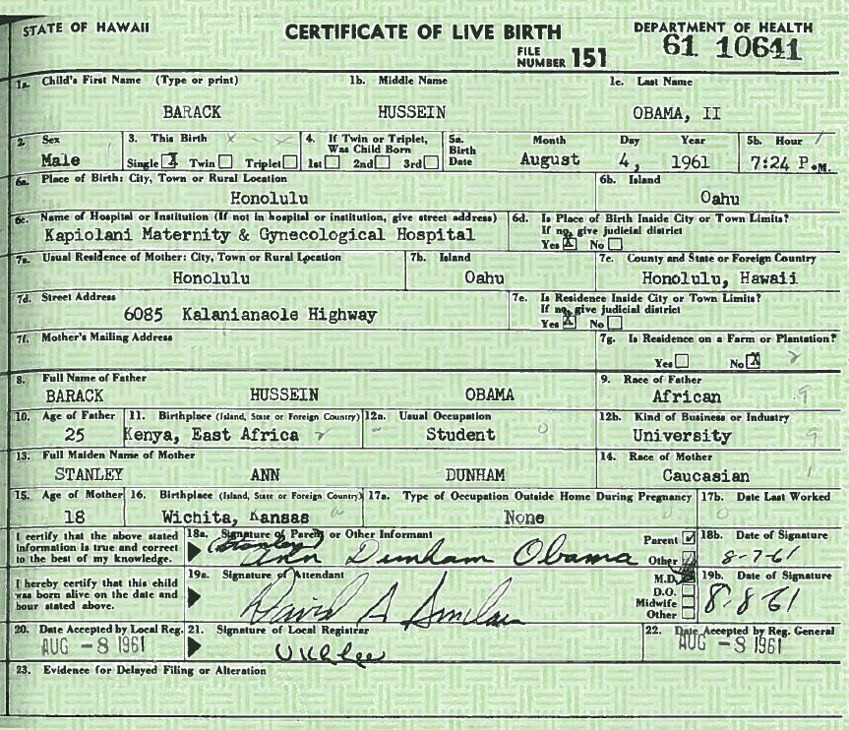
Scandals/Controversies The Obama Administration: Obama’s Birth Certificate
“The Birthers” alleged that Obama was born in Kenya or Indonesia, not in Hawaii
From 2008 to 2011, Obama benefitted by withholding his birth certificate. The controversy created a demographic of crazed kooks (“the birthers”)
In April 2011, Obama released his birth certificate after Donald Trump began to get traction with the public on the issue
Notes:
The Birther Controversy
Up until April 2011, conspiracy theorists floated the idea that Obama was not born in America, which the U.S. Constitution mandates as a qualification for president (Here’s what the Constitution says: “No Person except a natural born Citizen, or a Citizen of the United States, at the time of the Adoption of this Constitution, shall be eligible to the Office of President.” (Alexander Hamilton was not born in America, but he had become a citizen by 1787, so he would have qualified to be president, but he was killed in a dual in 1803, so Hamilton never had the opportunity to run for president). The conspiracy theorists theorized that Obama was born in Kenya, his father’s homeland, or in Indonesia. The president refused to release his birth certificate, and the state officials in Hawaii would not release it without Obama’s consent, so this added fire to the conspiracy, but it worked for Obama politically, because the controversy created a demographic of kooks (called “the birthers”). But the politics changed after Donald Trump began to flirt with a run for president (in late 2010 thru early 2011). Trump was gaining traction with potential voters by raising suspicion about the birth certificate—he argued that the president must be hiding something. After doing some focus group testing, President Obama believed it to be in his interest to release the birth certificate, which he did in late April 2011. Since it’s release, the “birther” controversy has almost entirely disappeared.
President Obama’s first term was largely scandal free, with a few minor exceptions (minor in terms of their threat to the Obama presidency), as noted below.
First-Term (Minor) Scandals (2009-2013)
The “Fast and Furious” program has been a minor scandal for the Obama administration. The program allowed Mexican drug gangs to purchase guns from Texas gun shops. The guns were then traced as they moved throughout the drug cartels. The program’s goal was to collect intelligence on the movement of the drug cartels. In the end, Brian Terry, a US border guard, was killed by a gun that slipped out of the country through the “fast and furious” program. Some 200 Mexicans on the other side of the border were also killed with “fast and furious” guns. The program was stopped once Terry was killed. But some Republicans have conspiratorial suspicions about why the Justice Department initiated the program, suspecting that they were making a case against assault rifles. In 2012, the US House held Eric Holder (the Attorney General) in contempt, demanding more documents regarding the program. The president has declared the documents in question as protected by executive privilege. Now there is a standoff between the US House and Justice Department. This was probably the closest the president had come to a serious scandal, prior to the Benghazi terrorist attack (Sept. 2012).
Another controversy that could have potentially haunted the Obama administration involved Joe Sestak, who won the Democratic primary for the US Senate in Pennsylvania in Mar. 2010 against Arlen Specter. The administration wanted Specter to win, and someone in the administration allegedly (according to Sestak) offered Sestak a job to encourage him to withdraw from the race so that Specter could win. This type of quid-pro-quo is illegal under federal law. Impeachment requires an actual crime to have been committed, which may have happened in this case. But this potential scandal disappeared. Sestak played down the offer after he won the Democratic primary, and Republicans did not pursue an investigation. Still, in the struggle for power, the opposition’s goal is to expose actual corruption or make the other side appear to be corrupt, all in an effort to make their side appear to be the better choice in the next election, and an alleged quid-pro-quo such as this could potentially blow up into a major scandal.
In July 2010, President Obama faced a potential race scandal. I detail what happened in the notes below slide #9 in the presentation on Race and Politics.

Slide 17
Scandals/Controversies The Obama Administration
IRS Targeting “Tea Party” and “Patriot” Groups
The threat to the Obama presidency?
This was a serious abuse of power…government power is not supposed to be used to suppress the opposition (though it sometimes happens)
Lois Lerner, the IRS official in charge, was suspended…Republicans made Lerner the target of their investigation, but there was never a threat to the president
Justice Department Targeting of News Reporters
The threat to the Obama presidency?
This was a serious violation of the principle of a free media, even liberals were critical of the policy, but the controversy passed—there was no threat to the Obama presidency
The Benghazi Terrorist Attack
The threat to the Obama presidency?
Not much of a threat to Obama—the president was guilty of not sensing the gravity of the situation in Benghazi, but he did not commit a crime
Hillary Clinton ran for president in 2016; she became the target of the Benghazi scandal, given that she was Sec. of State at the time the terrorist attack occurred and that requests had been made to the State Department for more security at the consulate in Benghazi, but those requests were denied
Notes:
The Obama administration was largely scandal free until the Benghazi terrorist attack in Libya and then revelations about the IRS targeting “tea party” and “patriot” groups for close scrutiny when applying for tax-exempt status and about a Justice Department investigation into AP and Fox News reporters, who may have been reporting on classified national security issues.
Targeting News Reporters
James Rosen, a Fox News reporter, was named as a co-conspirator in a leak of classified information about North Korea. Usually the leaker is targeted, who was likely a state department official, but it is highly unusual for the government to target a reporter, given how important a free media is to a democracy. From the perspective of conducting a criminal investigation, it makes sense to seize Rosen’s phone and email records to see who he spoke with at the state department, but the Obama administration (the Justice Department) went after Rosen (the reporter) as well, until both liberals and conservatives rallied behind Rosen, essentially defending the right to a free media without any harassment from government.
Benghazi Terrorist Attack
Regarding Benghazi, the President wanted the diplomatic mission there to blend in, not to be a fortress that would be imposing to the indigenous people of the area, but that made it vulnerable to an attack. When the attack occurred; the president was briefed about it, his military advisors assured him that they were on it, so the president retired to his room for the evening. Looking back, the compound was understaffed and ill-equipped to fend off an onslaught but the gravity of that fact was non impressed upon Obama. He just felt he had good capable people working the issue. If the president is guilty of anything, he is guilty of not sensing the gravity of the situation, which is why he wasn’t on the phone all night monitoring the events as they unfolded. This issue will resurface again. Hillary Clinton is running for president in 2016, and she was Sec. of State at the time, and it is the Sec. of State’s responsibility to ensure our embassies and diplomatic missions are secure, so this will be an issue leveraged against Hillary Clinton in the 2016 presidential race.
Other 2nd Term Scandals in the Obama Administration
Beau Bergdahl
The Obama administration swapped 5 Taliban commanders held at the Guantanamo Bay detention facility for Beau Bergdahl, the last American held captive in Afghanistan. The swap was made on May 31, 2014. The prisoner swap was immediately controversial because Bergdahl was allegedly a deserter, and administration critics argued that releasing 5 Taliban terrorists was a price to high to pay for Bergdahl’s release; in addition, the policy of our government is not to negotiate with terrorists—to negotiate Bergdahl’s release, the U.S. negotiated with the Taliban, a terrorist organization.
The controversy subsided while Bergdahl recovered at an army hospital, as the army investigated Bergdahl’s capture to determine if he deserted. In March 2015, the Army announced that it will try Bergdahl on desertion and for endangering fellow soldiers (some 6 soldiers were killed in unsuccessful search and rescue missions, looking for Bergdahl). Bergdahl could face life in prison.
Veteran’s Administration Hospitals
In April 2014, CNN reported that 30 – 40 veterans had died at a VA hospital in Phoenix because they received delayed treatment, and the VA hospital covered up the delays in treatment by manipulating the dates on which these veterans were treated, making it appear that they had been treated in a timely manner. Since, the media has learned that other VA hospitals around the country are guilty of the same, some 120,000 veterans have been wait-listed, thus not receiving timely treatment. The FBI is investigating for illegal activity at the VA hospitals.
Politically, the Secretary of Veterans Affairs, Eric Shinseki, was forced to resign in May 2014. A few other top-level managers in the VA has also resigned, as well as some of the administrators at the Phoenix VA hospital. The Obama administration has promised reform of the system.
This is not a scandal that will damage President Obama. He has positioned himself on the side of reform of the VA hospital system; some high-level resignations have already occurred, which gives the president political cover, appearing to be cleaning up the situation.
Secret Service Incompetence
The role of the Secret Service is to protect the president and his family. Julia Pierson, director of the Secret Service, was forced to resign after it was revealed that she had not told President Obama that an armed security guard rode an elevator with the president in September 2014 in Atlanta, when the president was visiting the Centers for Disease Control (CDC). The protocol is that only members of the president’s security detail can carry weapons when in proximity to the president.
Also in September 2014, a man scaled the White House fence and actually made it inside the WH, only to be tackled by an off-duty member of the Secret Service who just happened to be there. Later, it was reported that 6 people had scaled the WH fence during Obama’s term in office. Also, in 2011, a man fired bullets at the WH, and the Secret Service did not know that it had happened until a cleaning person found a bullet fragment some 4 days later. In 2012, in Cartegena, Columbia, an advance team of Secret Service agents hired prostitutes prior to the president’s arrival in Colombia. The prostitution scandal forced the then resignation of the Director of the Secret Service, and 8 agents were also fired.
In March 2015, two secret service agents drove a car into a barricade; both were apparently drunk. A few weeks later, the secret service promulgated new rules about drinking and driving government vehicles, that a secret service agent is not allowed to drive a government vehicle within 10 hours of consuming alcohol.
These secret service scandals won’t hurt the president. The president has taken on the side of reform and is not a cause of the problematic culture at the Secret Service.

Slide 18
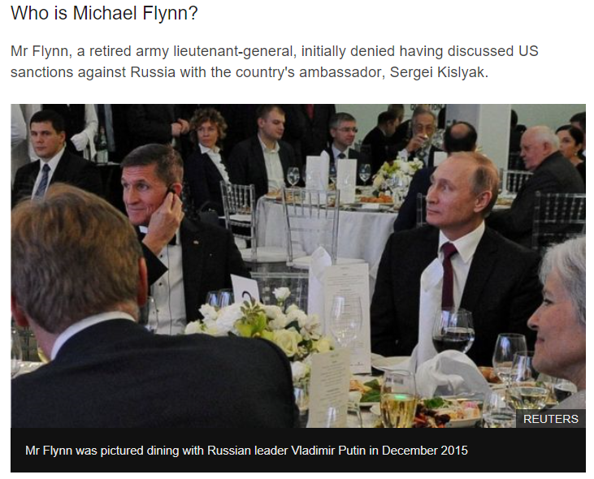
Trump Scandals/Controversies The Trump Administration: Connection between Trump and Russia??
The Allegation: The 2016 Trump campaign “colluded” and perhaps even “conspired” with Russians to expose damaging information against Hillary Clinton to influence the 2016 election
A “special prosecutor” (Robert Mueller) investigated; six (6) Trump campaign officials plead guilty or were indicted, but no Trump campaign official “cooperated” with the Russians to alter the election; still, the special prosecutor concluded Trump may have obstructed justice by not fully cooperating with the investigation
The Steele Dossier: The source of the Trump investigation (the Steele Dossier) was discredited; it was paid for by the 2016 Hillary Clinton presidential campaign
Trump’s first National Security Advisor, Michael Flynn, was fired after 24 days for lying to VP Mike Pence about Flynn’s contacts with Russian Ambassador (Sergei Kislyak) during the transition period (2016), the same day then President Obama issued economic sanctions on Russia for interfering in the US presidential election in 2016
Notes:
Regarding Michael Flynn, the Trump administration argues that the real story is the leak of Michael Flynn’s phone conversations with Ambassador Sergei Kislyak. Trump struck back against what he referred to as, “Russia, Russia, Russia,” claiming the real crime was the FBI’s release of Flynn’s phone conversations, allegedly, a violation of classified information laws. In addition, Trump and his backers investigated the FBI’s investigation of him, and they claimed that the FBI was biased against Trump. As it turns out, a number of FBI officials were fired or forced to resign because of the bias they displayed toward Trump during the 2016 presidential campaign and during the transition after Trump was elected but prior to his taking office. Members of the FBI are supposed to be non-partisan in their duties, but some were so threatened by a potential Trump presidency that they openly opposed him.
Russian intelligence is notorious for interfering in the elections of democracies, including the U.S. presidential election in 2016, but there was no evidence that the Trump campaign colluded with the Russians to undermine Hillary Clinton’s bid for president.
At the heart of the Russian Probe (i.e., “Trump’s allegedly colluding with Russia against Hillary Clinton during the 2016 presidential campaign”) was a report (called a “dossier”) compiled by Christopher Steele, a former UK intelligence officer, who claimed that Russia had damaging information on Trump as a businessman, allegedly including a video tape of prostitutes with Trump in a Moscow hotel in 2013, which allegedly showed that the prostitutes urinated on Trump in some sort of perverse sex act. The “pee tape” never existed; it was made up by a source Steele used named Igor Danchenko, who was later indicted for lying to the FBI. The FBI’s investigation of the Trump campaign was fueled by false information provided to the FBI and that, in an indirect way, the “Steele Dossier” was paid for by the 2016 Hillary Clinton campaign. In the end, Trump was mostly vindicated, but throughout most of his term in office, he was under a cloud of suspicion for “colluding” with Russia to undermine Hillary Clinton’s presidential bid in 2016. This is an example of the “Curse of Power.” Trump was so threatening to the political system that Hillary Clinton’s campaign resorted to dirty opposition politics to undermine Trump, and the FBI was so desperate to derail the Trump presidency that it accepted false testimony as justification to investigate the 2016 Trump Campaign.
Here is an article detailing the entire Russia collusion story: The Steele dossier: A reckoning | CNN Politics https://www.cnn.com/2021/11/18/politics/steele-dossier-reckoning/index.html
Here is a second article on Igor Danchenko: Main Steele dossier source Igor Danchenko was FBI operative (nypost.com) https://nypost.com/2022/09/14/main-steele-dossier-source-igor-danchenko-was-fbi-operative/
CNN has a tracker of how many people went to jail as a result of the Robert Mueller investigation into Russia’s interference in the 2016 presidential election: https://www.cnn.com/interactive/2017/politics/russia-investigations/#/charges

Slide 19
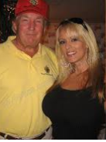
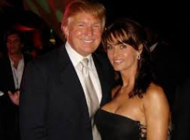
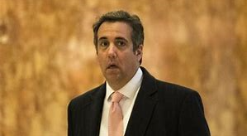
Trump Scandals/Controversies 2016 Presidential Campaign: Hush Money to Porn Stars & Playboy Centerfolds
Stormy Daniels
Karen McDougal
Trump paid $130,000 to Stormy Daniels in the final weeks of the 2016 campaign to keep a 2006 sexual affair from becoming public
The National Enquirer paid Karen McDougal $150,000 for her story about her 10 month relationship with Trump in 2006; the paper never printed the story
The Allegation: Michael Cohen made an “illegal” (corporate) campaign contribution to the Trump campaign to pay Stormy Daniels “hush money;” according to Cohen, the payment was made at Trump’s insistence
Michael Cohen, Trump’s former personal lawyer
Michael Cohen was Trump’s longtime personal lawyer and an advisor to Trump during the 2016 presidential campaign. He made a payment of $130,000 to Stormy Daniels to guarantee her silence about an affair Trump had had with Stormy Daniels in 2006. In August 2018, Cohen plead guilty to making an illegal campaign contribution (i.e., his payment to Stormy Daniels)
Notes:
Stormy Daniels (real name: Stephanie Cliffords) is in the picture on the top left. Karen McDougal is in the picture on the top right. Michael Cohen’s picture is below the top pictures of the women.
Trump’s defense regarding the campaign finance violation (i.e., Cohen’s “hush money” payment to Stormy Daniels) is that he reimbursed Cohen the $130,000—and—that a candidate can contribute as much money as he or she wants to their own campaign (in contrast to a “corporation,” which can only contribute $5,000 via a Political Action Committee).
https://www.newyorker.com/news/news-desk/donald-trump-a-playboy-model-and-a-system-for-concealing-infidelity-national-enquirer-karen-mcdougal – The link is to an article on Karen McDougal, a playboy centerfold who had a 10-month affair with Trump in 2006.

Slide 20
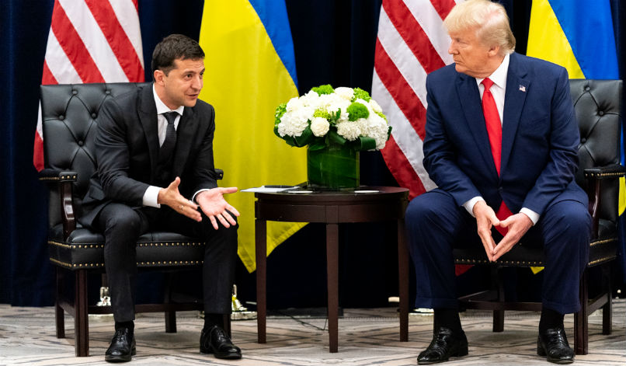
Trump Scandals/Controversies The Trump Administration: 1st Impeachment Asking Ukraine to Investigate Biden
Trump’s 25 July 2019 phone conversation with Volodymyr Zelenskyy, the Ukrainian president—and—a “whistleblower” complaint sparked the U.S. House to impeach Trump in December 2019
The Pretext for Impeachment: Trump solicited a foreign government (Ukraine) to interfere in the 2020 presidential campaign by freezing $391 million in military aid until Ukraine agreed to investigate the alleged connection between Joe Biden’s influence as Vice President and his son’s (Hunter Biden) lucrative business dealings in Ukraine
Volodymyr Zelenskyy and Donald Trump, Sept. 2019
The Law: Democrats accused Trump of soliciting a foreign leader for information on a campaign opponent—and—of withholding military aid after Congress had appropriated the aid. But Democrats did not charge Trump with a civil or criminal violation of the law
The Politics: Public opinion is crucial in an impeachment investigation, but public opinion was fairly evenly split on Trump’s impeachment. From Trump’s perspective, the public did not turn against him enough to scare Republicans in the Senate into voting for his removal from office
Impeachment/Removal Process: In the U.S. House, Democrats had a majority of votes to impeach Trump, but in the U.S. Senate, Democrats needed 20 Republicans to vote to remove Trump from office. Only 1 Republican voted to remove, so Democrats could not garner the 67 votes needed to remove
Notes:
Photo: Trump meets with Zelenskyy on Sept. 25, 2019.
Phone Conversation between Trump and Zelenskyy (7-25-2019, one day after the Robert Mueller testimony to Congress): https://www.cnn.com/2019/09/25/politics/donald-trump-ukraine-transcript-call/index.html
The Whistleblower Complaint: https://www.nytimes.com/interactive/2019/09/26/us/politics/whistle-blower-complaint.html
DOJ exonerates Trump of a crime: https://abcnews.go.com/Politics/trumps-doj-clears-president-violating-campaign-finance-law/story?id=65849857 – The allegation against Trump was that he solicited something “of value” from a foreign leader, which would be a violation of Federal Election Commission (FEC) rules governing elections in America. The DOJ criminal division concluded that nothing “of value” was exchanged in the 25 July 2019 phone call between President Trump and Vlodymyr Zelenskyy.
The removal vote in the Senate (Feb 5, 2020):
Abuse of Power – 48 votes to remove; 52 votes for acquittal
Obstruction of Congress – 47 votes to remove; 53 votes for acquittal
There were 47 Democrats and 53 Republicans in the U.S. Senate in Feb. 2020. The votes were party line with one exception. Mitt Romney (R-UT) voted to remove Trump on the article of “abuse of power.” Romney and Trump have a long history of animus. Romney asked for Trump’s endorsement in 2012 (when Romney ran for president against then President Obama, an election Obama won), and Trump gave Romney his endorsement. But when Romney lost the election, Trump was very critical of how Romney ran his campaign, saying that Romney had “choked.” Then, in 2016, Romney (and a whole bunch of other high-profile Republicans) did not vote for Trump. But Trump forgave Romney and considered him for Secretary of State and endorsed Romney when he ran for U.S. Senate in 2018 (Romney won and became a U.S. Senator from Utah). As a U.S. Senator, Romney criticized Trump’s outrageous behavior, such as Trump’s harsh critiques of Senator John McCain, even after McCain’s death. Their relationship continued to spiral downhill between 2018 and 2020, ultimately resulting in Romney voting to remove Trump from office on the count of obstruction of justice during the impeachment trial (Feb 2020).
For the Romney-Trump feud through 2018, see: https://time.com/5166393/donald-trump-endorses-mitt-romney-twitter/
For the Romney-Trump feud through 2020, see: https://thehill.com/homenews/campaign/481902-timeline-trump-and-romneys-rocky-relationship
The Biden Presidency
Joe Biden is protected from impeachment because he enjoys unified government at the outset of his presidency (January 2021), but should Republicans win a majority in the U.S. House in 2022, then Biden could face an impeachment inquiry. Almost certainly, Republicans would look into Biden’s business relationship with his son (Hunter Biden) and brother (Frank or Jame Biden), searching for any corrupt bargains that Biden might have made to help his son and brother secure business deals with the governments of Ukraine, China, and Russia, or with businesses tied to the governments of any of those countries. What Republicans would try to uncover is whether Biden profited personally from any of these business deals and whether there were any understandings or agreements that Biden would provide access to powerful people in the U.S. government in exchange for overseas governments or overseas businesses doing business with his son and brother.

Slide 21
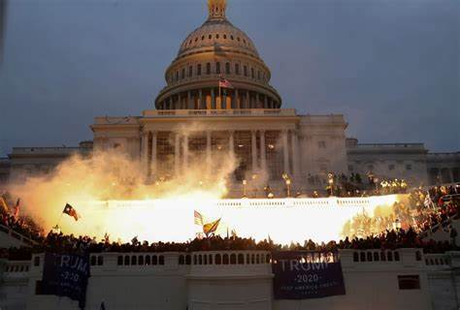
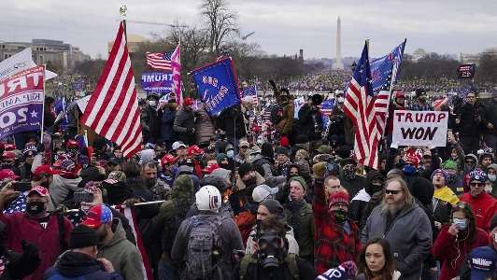
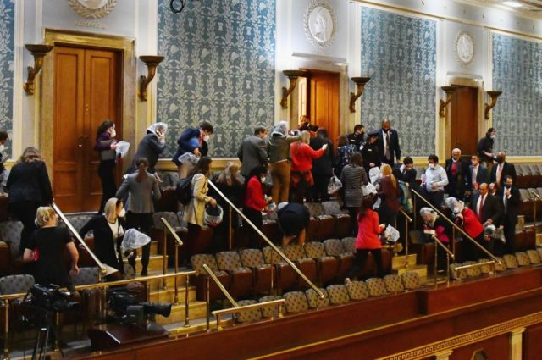
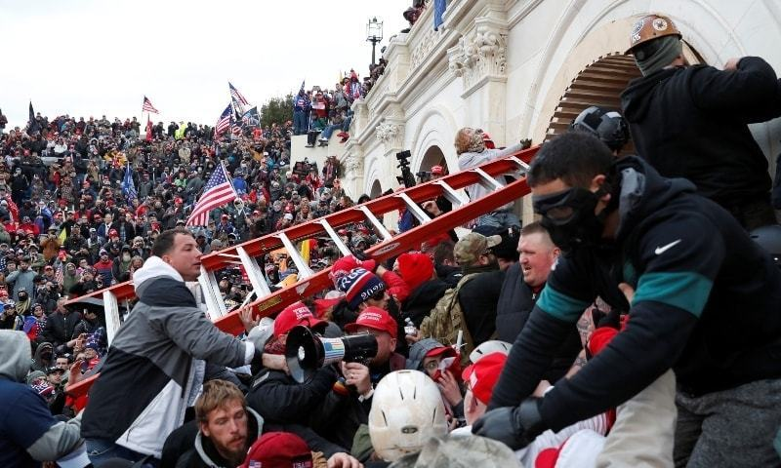
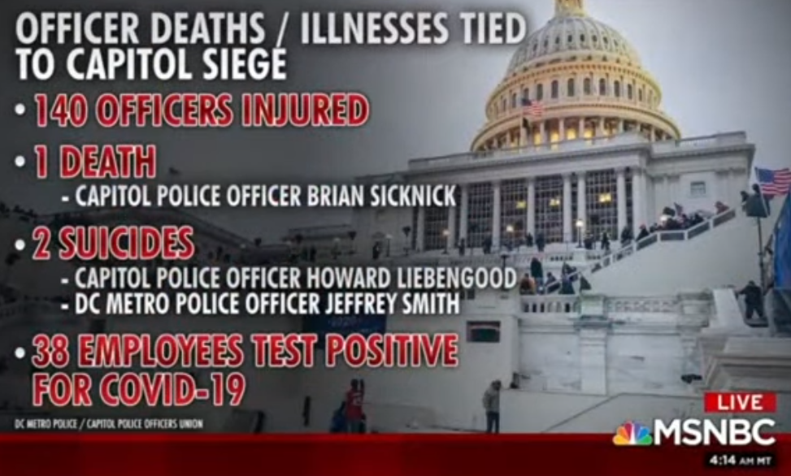
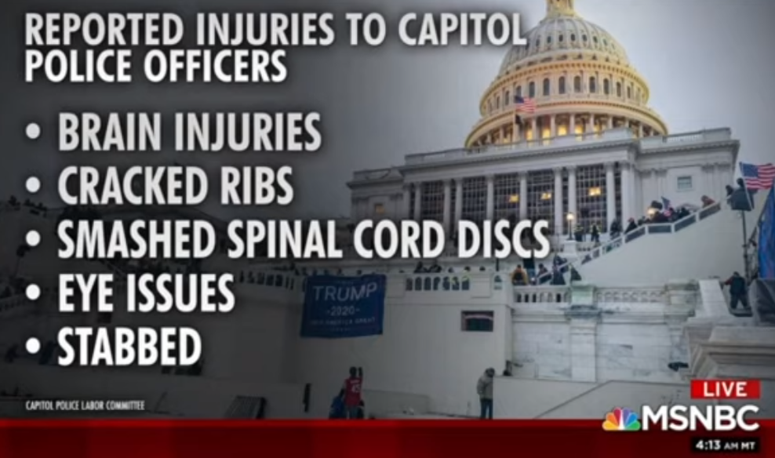
Trump Scandals/Controversies The Trump Administration: Trump Supporters Assault the Capitol Building
Trump Supporters Assault Capitol Building, 6 January 2021
Notes:
Donald Trump challenged the 2020 presidential election results in court, winning only 1 of 62 cases filed, in the 5 weeks following the 3 November 2020 election, including one to the U.S. Supreme Court, which dismissed the case for a lack of jurisdiction (Texas also brought a lawsuit to the US Supreme Court against Pennsylvania, Wisconsin, Arizona, and Georgia for counting ballots inconsistently within each of their respective states, which was the winning argument for George W. Bush in his contest of the Florida results in 2000, but this time, the Supreme Court would not hear the case because Texas has no jurisdiction regarding election laws in other states).
Even after the members of the Electoral College met to vote on Dec. 14th 2020, Trump still would not concede the election. Biden had received 306 electoral votes on 14 Dec. 2020 (270 electoral votes are needed for a majority and victory).
After 14 December 2020, Trump tried to influence election officials in various states, including Georgia, to no avail.
Congress officially counted the Electoral Votes on Jan. 6, 2021. Trump supporters in Congress, ~140 in the House and 6 or more in the U.S. Senate planned to object to the electoral count in Arizona, Georgia, Pennsylvania and Wisconsin. Objections can be raised under federal law, but it is not clear if Congress can overturn the Electoral College results. Theoretically, Congress could reject the votes of a state, if both chambers, House and Senate, vote to reject the votes. Then, again theoretically, neither candidate would have a majority and the election would then be decided by the U.S. House, with each state delegation being given 1 vote for president. This is a theoretical scenario because it has never played out this way in American history, but it was Trump’s one last desperate attempt to overturn the election results on Nov. 3, 2020.
As a last attempt to challenge the election results, Trump held a Save America March in Washington DC on Jan. 6, 2021. He claimed that he won the election and implored his supporters to “fight like hell” to save our country. He also encouraged his supporters to march “peacefully and patriotically” to the Capitol Building to have their voices heard. He suggested that the “weak” Republicans who don’t support his cause, as Congress counted the electoral votes, should be challenged in their next primary elections, presumably by a pro-Trump Republican.
Even before Trump had completed his speech, rioters had made their way to the Capitol Building, breaching the outer perimeters. 1000s more came to the Capitol Building after Trump’s speech, eventually punching through police resistance. They entered the Capitol Building vandalizing and ransacking offices, including Nancy Pelosi’s (the Speaker of the House). Some even called for VP Mike Pence to be hanged by a noose set up outside the Capitol Building.
One week later, the House impeached Trump for inciting the riot and for telling his supporters the “big lie,” that the election results could be overturned by Congress on Jan. 6, 2021.

Slide 22
Trump Scandals/Controversies The Trump Administration: 2nd Impeachment for Inciting a Riot at the Capitol
Trump was impeached for inciting a riot at the Capitol Building, 6 January 2021
Trump organized a “Save America March” on 6 January 2021 to encourage his supporters to call on Congress to overturn the election
The Pretext for Impeachment: Trump refused to concede the 2020 presidential election, misinforming his supporters into thinking the election result could be overturned as Congress counted the electoral vote on 6 January 2021. A violent riot ensued at the Capitol Building
The Law: Democrats accused Trump of inciting a riot in a speech on 6 Jan. 2021 and post-election (2020) for repeatedly lying to his supporters about the prospects of Congress overturning the election results on January 6, 2021.
The incitement charge was problematic because phrases like, “fight like hell,” are commonplace in political rhetoric, even Democrats use this phrase. “Fight” and “fight like hell” are protected as free speech under the 1st Amendment. Under the law, Trump was not guilty of inciting violence.
The Politics: Public opinion is crucial in an impeachment investigation, and the optics of a mob violently assaulting the Capitol Building turned public opinion against Trump, and more Republicans voted to impeach and remove Trump in his second impeachment, but the bulk of Republicans worried that Trump may still have influence over voters, and this fear influenced most Republicans to vote against impeachment and removal (i.e., to vote to defend Trump)
Impeachment/Removal Process: In the U.S. House, all Democrats and 10 Republicans voted to impeach Trump, 232 to 197 (4 did not vote). In the U.S. Senate, all 50 Democrats plus 7 Republicans voted to convict Trump (for a total of 57, which is short of the 2/3rd required (67 votes are required for conviction)), thus Trump was acquitted .
Notes:
The U.S. House filed a simple article of impeachment, that Trump incited his supporters to riot at the Capitol, and the House voted on the article one week after the assault on the Capitol Building, voting 232 to 197 to impeach, including 10 Republicans who joined all 222 Democrats to vote to impeach.
READ: House article of impeachment against Donald Trump – CNNPolitics – See the impeachment article here. The article of impeachment quotes Trump from his 6 January 2021 speech, for making a false claim, "we won this election, and we won it by a landslide,“ and for inciting the crowd to violence with this statement, “"if you don't fight like hell you're not going to have a country anymore." It also cites Trump for threatening the Secretary of State of Georgia in a 2 January 2021 phone call for not reversing the vote in that state, and generally summarizes Trump’s actions this way, "He threatened the integrity of the democratic system, interfered with the peaceful transition of power, and imperiled a coequal branch of Government.”
It is this last statement, “imperiled a coequal branch of Government,” that prompted Senate Minority Leader, Mitch McConnell (R-KY), to reconsider his support for Trump. Being very protective of the U.S. Senate and of Congress more generally, as a separate branch of government, (as of Jan. 2021) Mitch McConnell hinted that he would break from Trump and possibly vote against him at the Senate trial. Had McConnell broken with Trump (which in the end he did not break with Trump), then more Republican Senators might have as well. 17 Republicans and all 50 Democrats would have had to have voted against Trump to “remove” him from office (2/3rds of the 100 U.S. Senators). Of course, Trump left office on 20 January 2021, and some Republican Senators believed it was not constitutional for the Senate to move forward with a Senate trial of a president who had already left office.
The Senate trial was controversial, in part, because Trump was no longer in office, and a Senate impeachment trial is about “removal” of “the president.” “The president” was Joe Biden at the time of Trump’s second impeachment trial for incitement. There is a precedent for “ex-parte” decisions of the U.S. Supreme Court, i.e., deciding a case that is moot because the underlying cause of action is no longer relevant. For instance, the U.S. Supreme Court decided a case regarding the use of military courts during the Civil War, after the Civil War had concluded in 1866. The Court felt it was important to set a standard as to when and where military courts could be used when America was at war, so it decided the case even though the war was over and military courts were no longer being used. So, in a similar sense, the U.S. Senate still wanted to adjudicate Trump’s actions, “ex-parte,” even though he was no longer president.
The U.S. Constitution requires that the Chief Justice of the United States (or of Supreme Court) preside over a Senate impeachment trial of “the president.” Since “the president” was no longer Donald Trump when the impeachment trial commenced on Feb. 8th 2021, John Roberts (Chief Justice of the US Supreme Court) did not preside. It is not clear whether John Roberts was asked to preside by Senate Democrats. The Majority Leader, Chuck Schumer (D-NY), said in an interview just prior to the trial that John Roberts would not preside, but he didn’t say if Roberts was asked and said no or whether he just wasn’t asked.

Slide 23
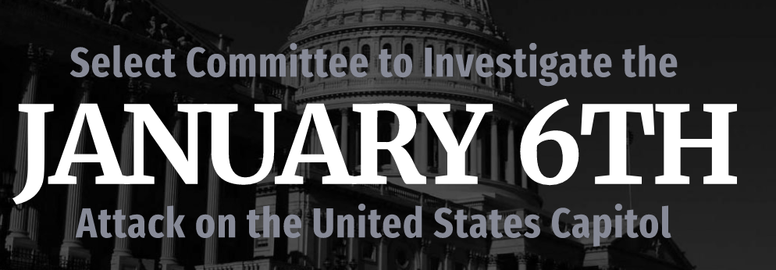
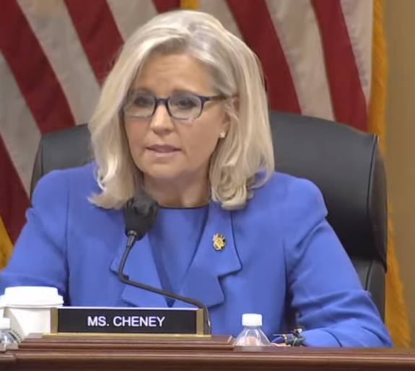
Trump Scandals/Controversies Trump Post-Presidency: Jan. 6th U.S. House Committee Investigation
From June – October 2022, the January 6th House Committee set out to document what President Trump was doing while rioters attacked the U.S. Capitol for 3 hours on 1/6/2021
Through deposition testimony provided to the committee by people close to Trump (e.g., staff, advisors, cabinet secretaries), the committee also set out to document that Trump knew that the 2020 presidential election had not been stolen from him
The committee also presented evidence that the attack on the U.S. Capitol was first initiated by members of the Proud Boys, a nationalist group
The Politics: The January 6th House committee’s several objectives: 1) Get the facts out about what happened on Jan. 6th 2021, and 2) Persuade the U.S. Justice Department to indict Donald Trump on obstructing an official Congressional proceeding and conspiracy to defraud the American people by attempting to reverse the election results, and 3) Impugn Donald Trump so much so that he will no longer be a force in American politics
Notes:
Source: Hearings | Select Committee to Investigate the January 6th Attack on the United States Capitol (house.gov) https://january6th.house.gov/legislation/hearings

Slide 24
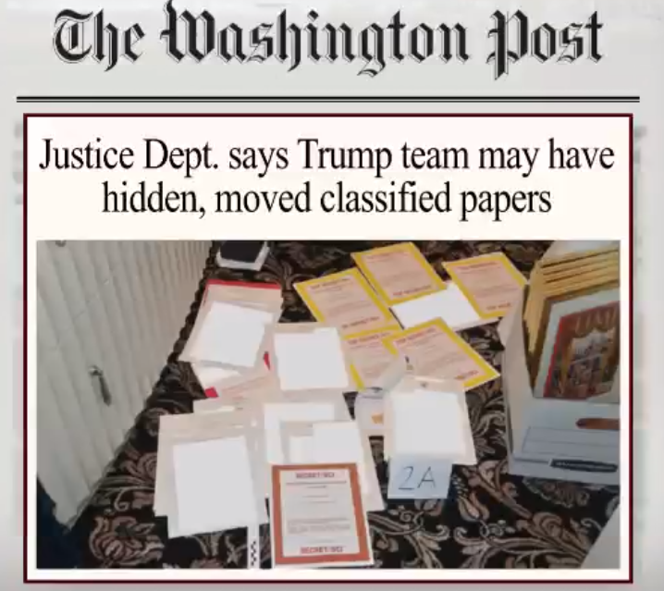
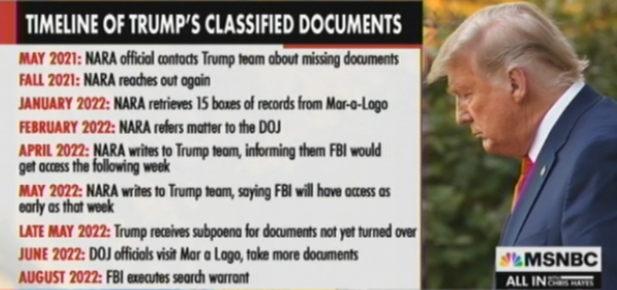
Trump Scandals/Controversies Trump Post-Presidency: National Archive Document Scandal
On August 8, 2022, the DOJ’s FBI raided Donald Trump’s residence at Mar-a-Lago in Florida, seizing classified documents that Trump had taken from the White House when he left on January 20, 2021.
The documents belong to the National Archive Record Administration (NARA), and Trump had been in negotiations with NARA, returning 15 boxes of documents in January 2022, but NARA felt that Trump was stonewalling, asked the DOJ to intervene
The Law: Trump could be indicted for mishandling classified documents, and his facing a criminal lawsuit could derail his plans to run for president in 2024
Notes:
DOJ – Department of Justice FBI – Federal Bureau of Investigations
https://www.cnn.com/2022/09/02/politics/mar-a-lago-seized-documents-inventory/index.html – A list of documents seized from Donald Trump’s residence at Mar-a-Lago.
Since Trump’s classified document scandal broke in August 2022, in January 2023, Joe Biden (the president) and Mike Pence (VP under Trump) have been found to have classified documents at their respective homes. Apparently, taking classified documents after one leaves office is more common than anyone expected. During the 2016 presidential campaign, Hillary Clinton’s email scandal was also about how she might have mishandled classified information.
Biden and Pence are cooperating with the FBI and DOJ in getting the documents back to the National Archives, while Trump is fighting the FBI and DOJ, believing this is the “deep state” trying to derail his 2024 run for president.
Biden’s classified documents: A timeline of the investigation (axios.com) https://www.axios.com/2023/01/12/biden-classified-documents-timeline – Here is a timeline of Biden’s document scandal
A timeline of the discovery and disclosure of classified records tied to Biden | PBS News Hour A timeline of the discovery and disclosure of classified records tied to Biden | PBS NewsHour https://www.pbs.org/newshour/politics/a-timeline-of-the-discovery-and-disclosure-of-classified-records-tied-to-biden – Here is a second timeline of classified documents found in Biden’s possession
Classified documents discovered at Mike Pence's Indiana home (axios.com) https://www.axios.com/2023/01/24/mike-pence-classified-documents – Here is a story on classified documents found at Mike Pence’s home

Slide 25
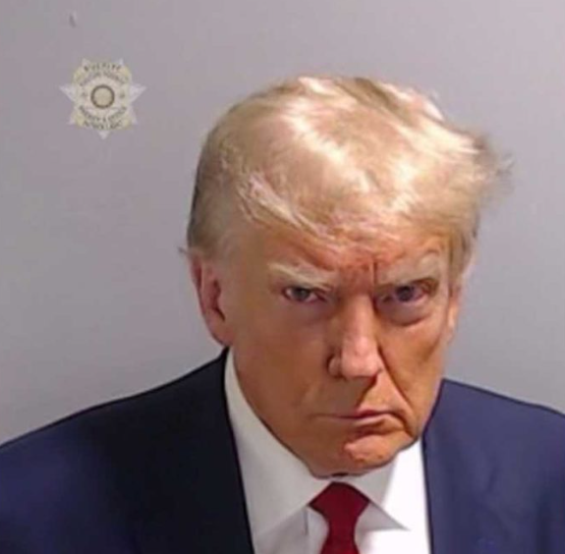
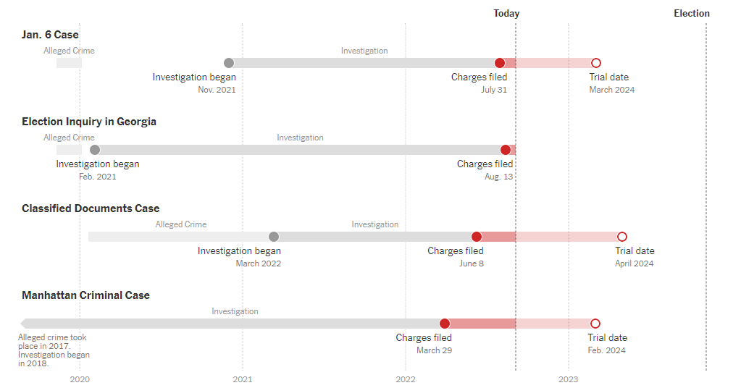
Trump Scandals/Controversies Trump Post-Presidency: Criminal Indictments
In his post-presidency, Trump has been criminally indicted in 4 separate courts:
Jan 6th Riot: Conspiracy to defraud U.S. (trying to reverse election) + obstruction of official proceeding
Classified Documents: Espionage (sharing national security secrets with unauthorized people); obstruction of investigation; false statements
Election in Georgia: Soliciting an official to violate oath + 6 others
Manhattan Business Fraud: Falsifying business records (covering hush money payment to Stormy Daniels) + violating federal campaign finance laws
The Law: If Trump is found guilty of crimes, he would likely be sentenced to time in jail or prison
The Politics: The political goal underlying Trump’s criminal prosecutions is to eliminate him as a candidate for president in 2024.
It is not clear what happens if Trump is sentenced to jail or prison—and—he wins the presidential election in 2024
Notes:
Source of Photo: Photo: Mug shot of Donald Trump released after arrest in Georgia | PBS NewsHour https://www.pbs.org/newshour/politics/photo-mugshot-of-donald-trump-released-after-arrest-in-Georgia
Source of graphic: https://www.nytimes.com/interactive/2023/us/trump-investigations-charges-indictments.html?auth=login-google1tap&login=google1tap
Status of Criminal Indictments against Trump (Oct 2023): Developments in Trump’s galaxy of legal problems, explained | CNN Politics https://www.cnn.com/2023/11/04/politics/trump-trials-what-matters/index.html There is a great graphic in this article, showing Trump at the center, and all of those heading investigations into his actions and behaviors surrounding him.

Slide 26
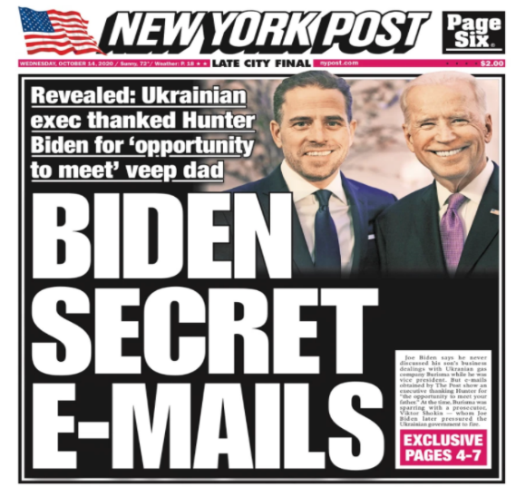
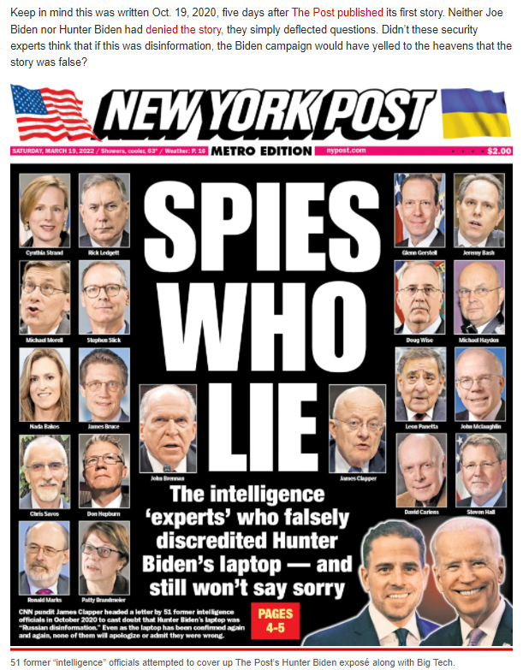
Biden Scandals/Controversies Hunter Biden: Did Joe Biden Profit from Hunter Biden Business Deals?
In 2020, most media outlets did not report on Hunter Biden’s lucrative business dealings in foreign countries, believing any allegations of wrongdoing were the product of Russian disinformation
In Sept. 2023, the U.S. House opened an impeachment inquiry of Joe Biden. The Republicans in the House are investigating whether Joe Biden personally profited from lucrative business deals between Hunter Biden and businesses in foreign countries with ties to their home governments (e.g., Ukraine, China, Russia)
One allegation is that Hunter sold access to his father (Joe Biden), who then, allegedly, could use his contacts in the U.S. government to help these foreign companies and their home country’s governments. A second allegation is that Joe Biden personally profited from these business deals
Notes:
Source of top graphic: https://nypost.com/2020/10/14/hunter-biden-emails-show-leveraging-connections-with-dad-to-boost-burisma-pay/ -- The story was published on 10/14/2020. Source of bottom graphic: https://nypost.com/2022/03/18/intelligence-experts-refuse-to-apologize-for-smearing-hunter-biden-story/?msclkid=7e4be9ecaa6f11ecb024d899f224c9e9

Slide 27
Conclusion
Are we likely to see more impeachment (impeachment-like) scandals in the future? Yes.
In the polarized environment that currently exists, it is highly likely there will be impeachment scandals in the future
The Nixon, Reagan and Clinton impeachment efforts reflect a trend in modern American politics: Impeachment or impeachment-like investigations have become a legitimate tool to discredit a president
There were many calls for Bush’s impeachment, but Bush was never linked to a crime (allegedly lying to the American people about the reasons for going to war in Iraq is not a crime)—and—the Democrats were poised to do well in 2008 and didn’t want to take a risk on impeaching Bush, which could have backfired politically
Obama was protected by a Democratic Congress in his first two years, but by 2014, Republicans controlled both chambers; still, Obama avoided impeachment-like scandals; nevertheless, he was vulnerable to scandal and controversy, just like other presidents in the modern era
Trump’s unorthodoxy (a norm-defying non-politician) was not received well by the Washington establishment, and he was impeached twice
Notes:
Source: https://www.needtoimpeach.com/#media-cta
The link above is to a website to petition for President Trump’s impeachment. Tom Steyer, a billionaire who made his fortune in the high tech industry, is leading the “impeach Trump” campaign. Our system has evolved to a standard for impeachment of a president, and that standard is that a president must violate the law. Steyer lists 9 possible offenses Trump has allegedly committed that could rise to the level of impeachment: see https://www.needtoimpeach.com/impeachable-offenses/

